Slide 1
SECURITY

Slide 2
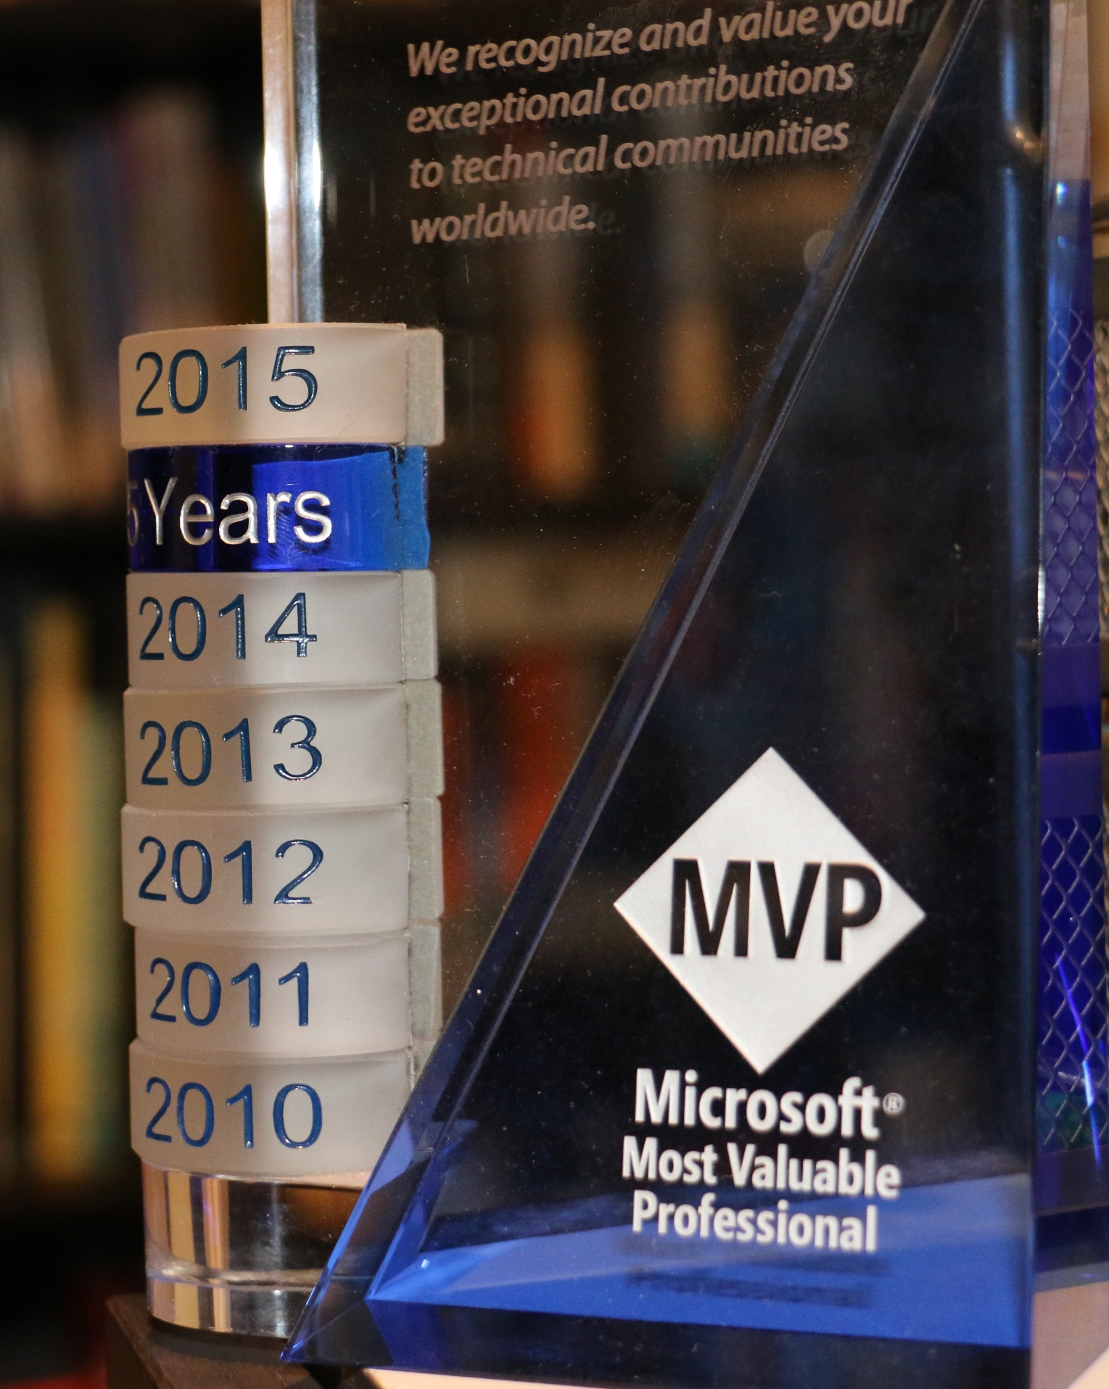
COMMON GROUND SECURITY
CGS INTRODUCTIONS
Notes:
Professional Hacker 20+ years experience
Founder of CactusCon
Ex-Microsoft MVP
Phd Student - AI

Slide 3
Welcome to the Industry

Slide 4
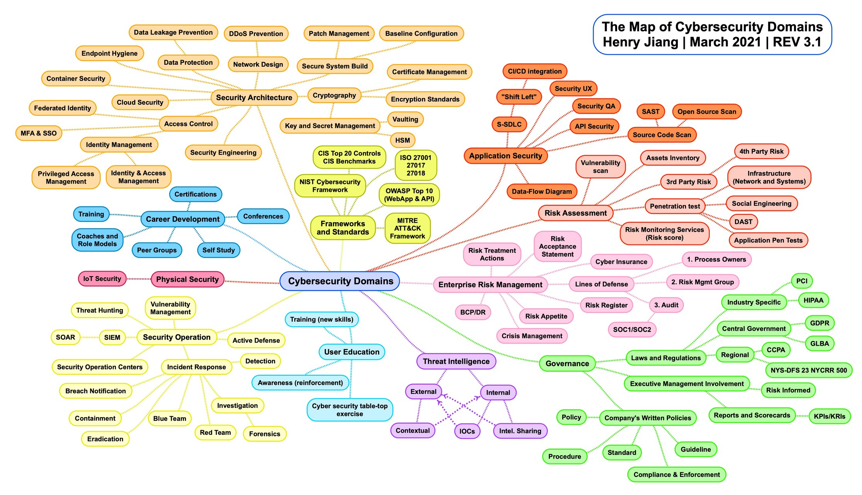
Introduction to Cybersecurity
CYBER SECURITY DOMAINS

Slide 5
Global cybersecurity job vacancies grew by 350 percent, from one million openings in 2013 to 3.5 million … and remains at 3.5 million in 2023
Cybersecurity Jobs Report: 3.5 Million Unfilled Positions In 2025 (cybersecurityventures.com)

Slide 6
Introduction to Cybersecurity
CYBER SECURITY JOB CATEGORIES
Governance
Offensive Security
Defensive Security
Defines organizational strategies around cyber defense and compliance. Risk reduction and management
Supports control validation to ensure that security has been properly implemented and is effective. Sometimes helps tests security teams
Works to protect systems through secure design, architecture, implementation, monitoring, and responding to threats in real-time.
Security Tooling
Software engineering to support both offense, defense, and security implementations. Helps protect systems at scale.

Slide 7
Introduction to Cybersecurity
CYBER SECURITY GOVERNANCE
This group is largely focused on the policies, strategies, compliance and regulation formats that impact business to perform in a secure fashion.

Slide 8
Introduction to Cybersecurity
CYBER SECURITY DEFENSE
Defense is responsible for implementing and managing the technological efforts that are required to create a secure operating environment for businesses.

Slide 9
Introduction to Cybersecurity
CYBERSECURITY OFFENSE
Offensive security is focused on the assessment of existing controls and software to make sure any of it works as designed to protect data.

Slide 10
Degrees that Matter?

Slide 11
Introduction to Cybersecurity
CYBER SECURITY CORE COMPETENCIES
Cryptography
Data Handling
Identity and Access
Everyone should know something about how we protect data at rest or in transit with cryptography
Not all data is handled the same, and all roles are required to manage data in its various forms.
What is authority, how do you establish digital identity? What is considered sufficient proof online?
System Security
Password Security
Vulnerabilities
We are protecting systems, so you need to know systems and patching and what security hygiene is.
How is it stored safely, what constitutes a good password and why, and how does 2fa come into play?
Threat actors attack systems, understanding the basics on how they do that and why becomes important for all jobs.

Slide 12
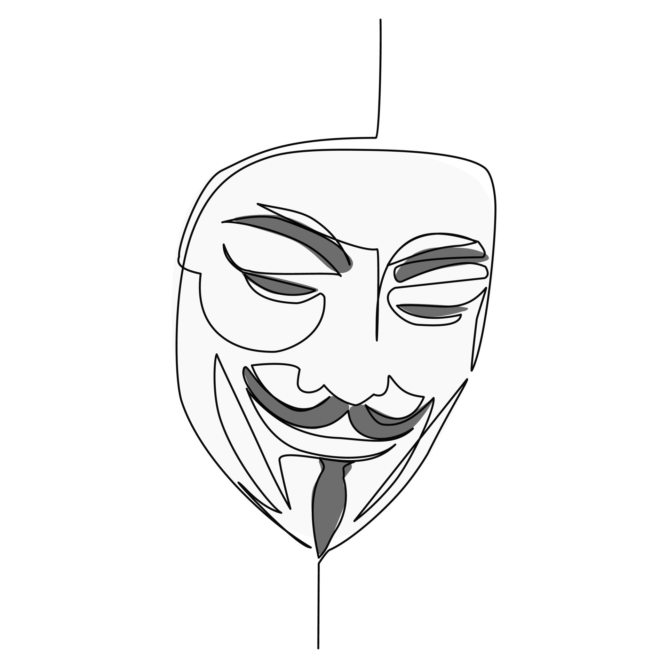
…Stories from the field…

Slide 13
PRESENTATION TITLE
CGS FINAL THOUGHTS
Security is a cross-discipline field
It requires technical & non-technical skills
Standing out requires you to show initiative in the jobs you want to work in
Proof speaks louder than a resume

Slide 14
Introducing Cybersecurity
CONTACT ME
@kuzushi www.linkedin.com/in/awilsonaz
https://sensecurity.io
kuzushi@sensecurity.io

